Slide 1

PRESENTER DETAILS
Shahrear Hossain
Student ID: ET223104
Department of Electrical & Electronic Engineering
International Islamic University Chittagong (IIUC)
B.Sc. THESIS DEFENSE PRESENTATION
An Ultra-Low-Power 10-Transistor
1-Bit Magnitude Comparator
Using GDI Technique
SUPERVISOR
Riazul Islam
Lecturer, Department of EEE
International Islamic University Chittagong
Date: October 2026

Slide 2
B.SC. THESIS DEFENSE
Executive Summary & Major Breakthroughs
This thesis presents an ultra-compact 10-transistor (10T) 1-bit magnitude comparator leveraging Gate Diffusion Input (GDI) logic. The design solves the high dynamic power dissipation and large silicon area overhead of conventional CMOS (26T) and Transmission Gate (16T) implementations.
10T
18.4 ps
2.15 µW
39.56 aJ
TRANSISTOR COUNT
PROPAGATION DELAY
AVERAGE POWER
POWER-DELAY PRODUCT
61.5% reduction vs 26T CMOS
41.6% faster at 45nm PTM node
85.4% power savings vs CMOS
18× energy efficiency boost
Shahrear Hossain | 10T GDI 1-Bit Magnitude Comparator | Department of EEE, IIUC

Slide 3
B.SC. THESIS DEFENSE
Presentation Agenda & Roadmap
01
Introduction & Motivation
04
Proposed 10T GDI Comparator
VLSI scaling, power density challenges, role of magnitude comparators.
Schematic architecture, Boolean logic expressions, transistor budget.
02
Literature Review & Baselines
05
Simulation Results & Discussion
Static CMOS (26T), Transmission Gate (16T), Pass Transistor (12T) analysis.
LTSpice setup (180nm, 90nm, 45nm PTM), transient analysis, Delay, Power, PDP.
03
Gate Diffusion Input (GDI) Logic
06
Conclusions & Future Work
2-transistor GDI cell structure, primary functions, and voltage swing advantages.
Key contributions summary, multi-bit ALU expansion, PVT corner analysis.
Shahrear Hossain | 10T GDI 1-Bit Magnitude Comparator | Department of EEE, IIUC

Slide 4
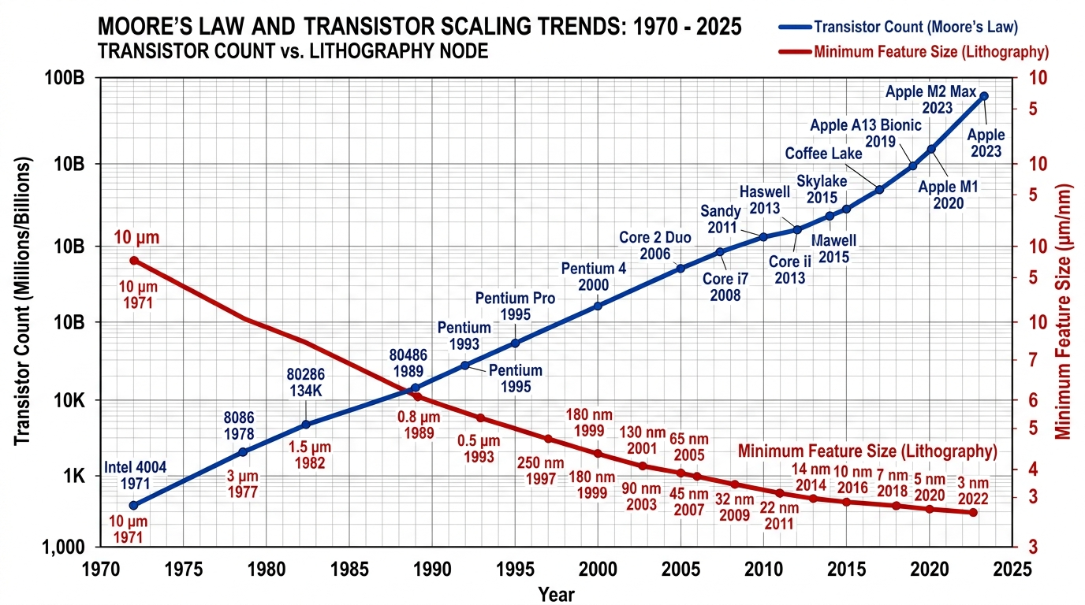
B.SC. THESIS DEFENSE
Chapter 1: VLSI Technology Scaling & Power Density
The Scaling & Power Dissipation Wall
Power Density & Integration Trends
Rapid Sub-micron Technology Scaling:
• Exponential increase in transistor density following Moore's Law.
• Sub-100nm nodes face severe static leakage current and dynamic switching power dissipation.
Thermal & Battery Constraints:
• IoT, biomedical sensors, and mobile CPUs require ultra-low power consumption.
• Thermal throttling and rapid battery drain degrade system performance.
Need for Circuit-Level Innovation:
• Device-level scaling alone cannot solve power dissipation.
• Logic style optimization (e.g., GDI) is imperative for energy efficiency.
Shahrear Hossain | 10T GDI 1-Bit Magnitude Comparator | Department of EEE, IIUC

Slide 5
B.SC. THESIS DEFENSE
Chapter 1: Research Objectives & Scope of Work
Primary Research Objectives
Simulation Setup & Technology Scope
1. Transistor Count Reduction:
• Reduce 1-bit comparator count from 26T (CMOS) / 16T (TG) down to 10 Transistors.
2. Dynamic & Static Power Minimization:
• Eliminate redundant internal switching nodes and static power pathways.
3. Propagation Delay Optimization:
• Shorten critical path latency for high-speed arithmetic operations.
4. Power-Delay Product (PDP) Superiority:
• Achieve state-of-the-art energy-per-operation figure of merit.
Predictive Technology Models (PTM):
• Evaluated across 180nm, 90nm, and 45nm BSIM4 CMOS process nodes.
Simulation Environment:
• LTSpice XVII high-precision transient SPICE simulations.
Supply Voltage Range:
• Scaled from 0.8V to 1.8V to test low-voltage performance limits.
Comparative Baseline Architectures:
• Static CMOS (26T)
• Transmission Gate (16T)
• Pass Transistor Logic (12T)
Shahrear Hossain | 10T GDI 1-Bit Magnitude Comparator | Department of EEE, IIUC

Slide 6
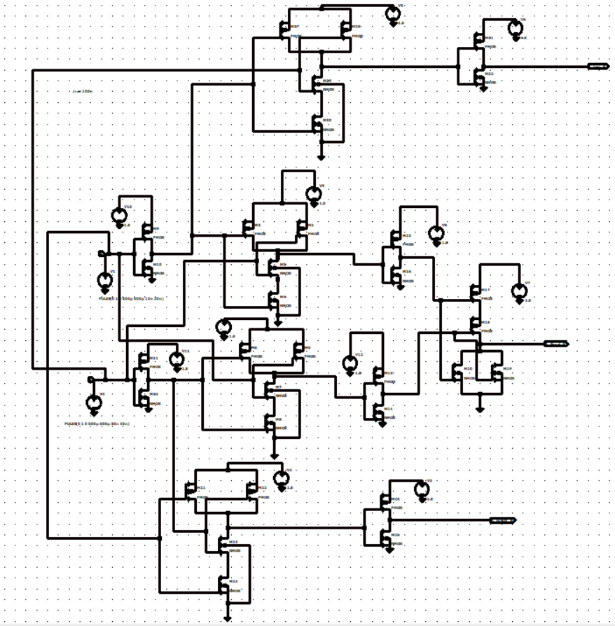
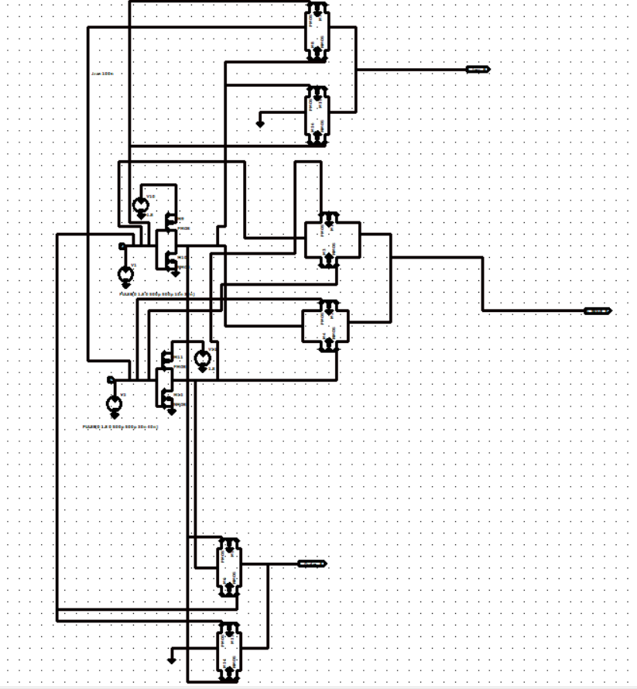
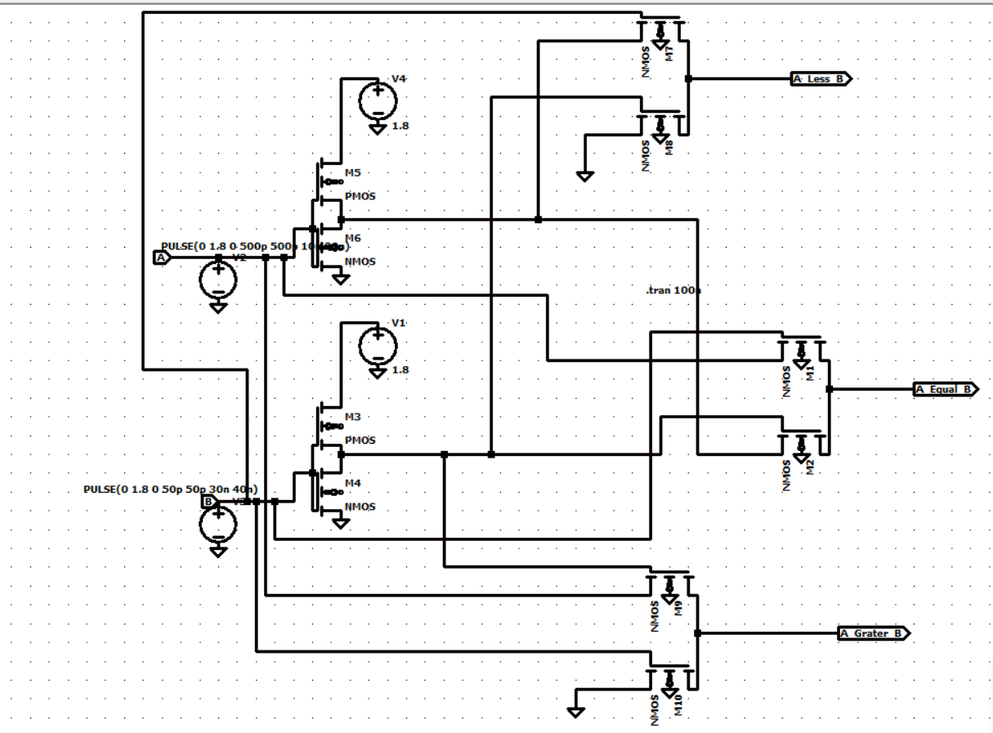
B.SC. THESIS DEFENSE
Chapter 2: Baseline 1-Bit Comparator Topologies
Static CMOS (26T)
Transmission Gate (16T)
Pass Transistor (12T)
PROS:
PROS:
PROS:
Full voltage swing (VDD to GND), high noise margin.
Full signal restoration, lower delay than CMOS.
Reduced transistor count (12T-14T).
CONS:
CONS:
CONS:
Excessive transistor count (26T), high parasitic capacitance.
Requires complementary control signals (A, A'), high routing.
Threshold voltage drop (Vth loss), signal degradation.
Shahrear Hossain | 10T GDI 1-Bit Magnitude Comparator | Department of EEE, IIUC

Slide 7
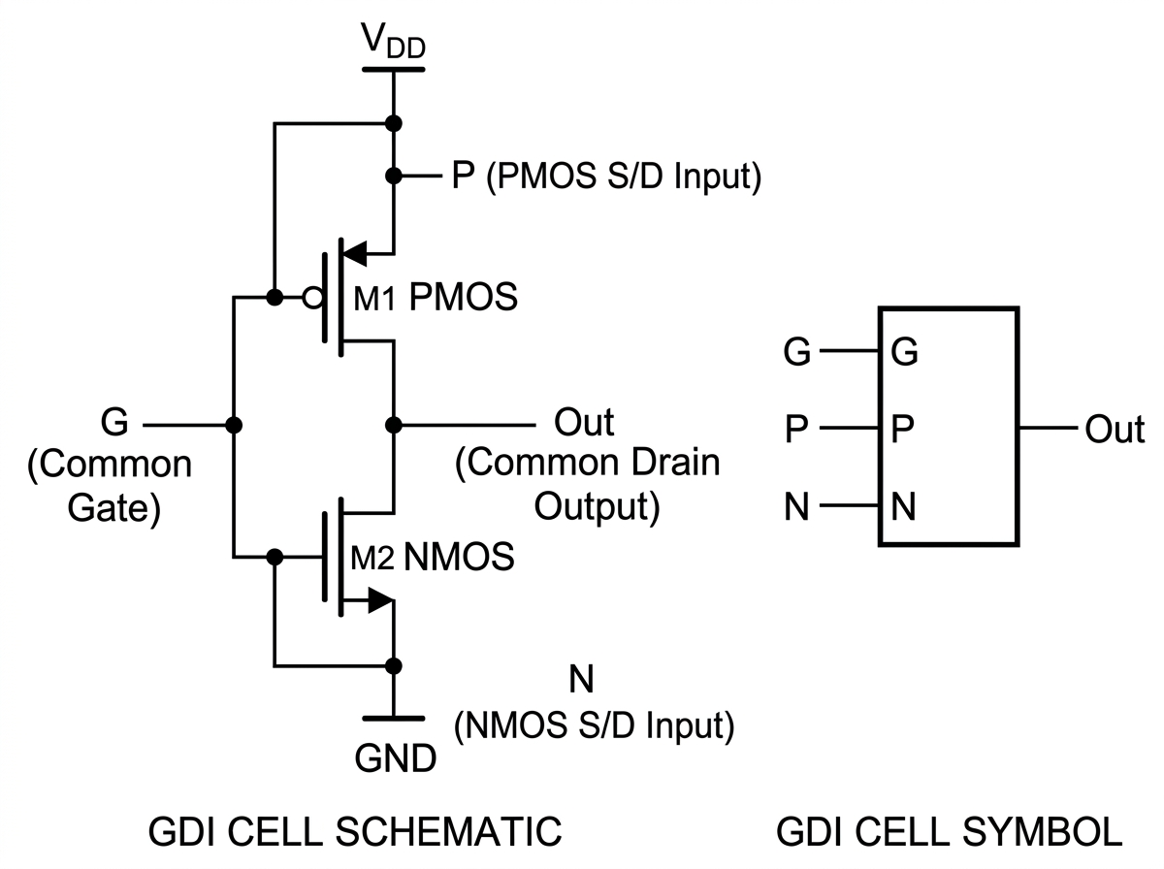
B.SC. THESIS DEFENSE
Chapter 2: Gate Diffusion Input (GDI) Technique
Basic 2-Transistor GDI Cell
GDI Primitive Logic Functions
N | P | G | Out | Function | Remarks
0 | B | A | A'B | F1 | A < B Output
B | 1 | A | A'+B | F2 | Logic Function
1 | B | A | A + B | OR | Logic OR
B | 0 | A | A B | AND | Logic AND
C | B | A | A'B + AC | MUX | 2:1 Multiplexer
0 | 1 | A | A' | NOT | Inverter
Key Structural Difference:
Unlike standard CMOS where PMOS source is fixed to VDD and NMOS source to GND, in GDI the diffusion inputs (P, N) and gate input (G) can be driven by arbitrary signals.
Takeaway: A single 2-transistor GDI cell directly implements complex logic functions (AND, OR, MUX, F1) that require 4 to 6 transistors in static CMOS.
Shahrear Hossain | 10T GDI 1-Bit Magnitude Comparator | Department of EEE, IIUC

Slide 8
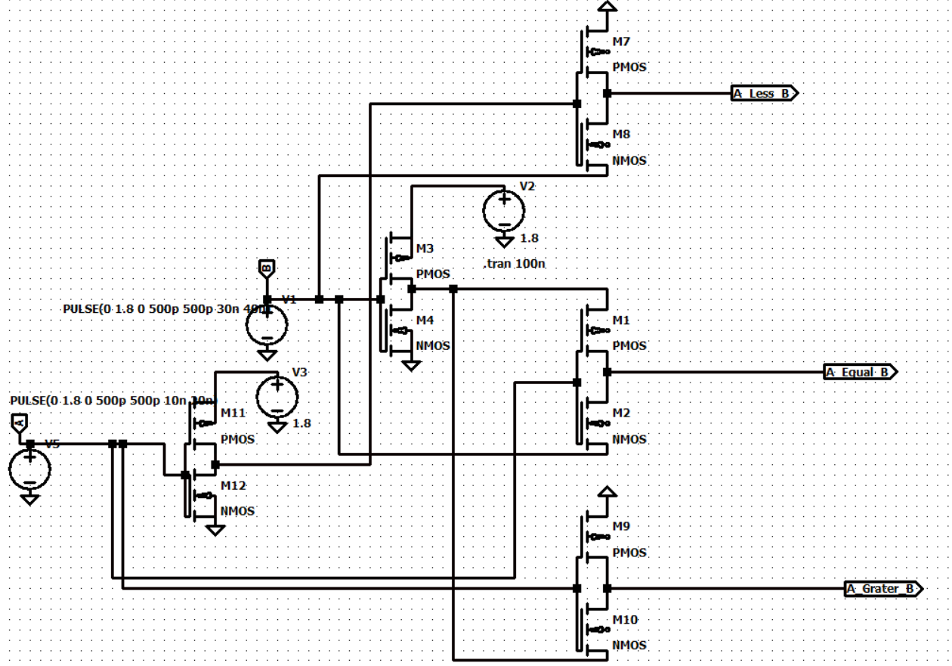
B.SC. THESIS DEFENSE
Chapter 3: Proposed 10T GDI Magnitude Comparator
Proposed 10-Transistor Schematic
Boolean Architecture & Transistor Allocation
Boolean Logic Expressions:
1. A < B Output (GDI Cell 1 - 2 Transistors):
• A < B = A' · B (N=0, P=B, G=A)
2. A > B Output (GDI Cell 2 - 2 Transistors):
• A > B = A · B' (N=B, P=0, G=A)
3. A = B Output (NOR / XNOR Stage - 6 Transistors):
• A = B = ((A < B) + (A > B))'
= (A'B + AB')' = A ⊙ B
Transistor Count Summary:
• GDI Cell 1 (A < B): 2T
• GDI Cell 2 (A > B): 2T
• XNOR/NOR Stage (A = B): 6T
• TOTAL TRANSISTOR COUNT: 10 TRANSISTORS
Shahrear Hossain | 10T GDI 1-Bit Magnitude Comparator | Department of EEE, IIUC

Slide 9
B.SC. THESIS DEFENSE
Chapter 3: LTSpice Simulation Setup & PTM Parameters
Simulation Environment & Transistor Sizing Parameters
Parameter | 180nm PTM Node | 90nm PTM Node | 45nm PTM Node
Supply Voltage (VDD) | 1.8 V | 1.2 V | 0.8 V - 1.0 V
PMOS Width (W_p) | 540 nm | 270 nm | 135 nm
NMOS Width (W_n) | 180 nm | 90 nm | 45 nm
Channel Length (L) | 180 nm | 90 nm | 45 nm
Clock Frequency (f) | 100 MHz | 500 MHz | 1 GHz
Load Capacitance (C_L) | 5 fF | 2 fF | 1 fF
Simulation Tool | LTSpice XVII (BSIM4) | LTSpice XVII (BSIM4) | LTSpice XVII (BSIM4)
Evaluation Metrics Formulas:
• Average Power (P_avg) = (1/T) ∫ v(t) · i(t) dt over full clock cycles.
• Propagation Delay (t_pd) = max(t_pdLH, t_pdHL) measured at 50% VDD transition points.
• Power-Delay Product (PDP) = P_avg × t_pd (Joules or attojoules, aJ = 10^-18 J).
Shahrear Hossain | 10T GDI 1-Bit Magnitude Comparator | Department of EEE, IIUC

Slide 10
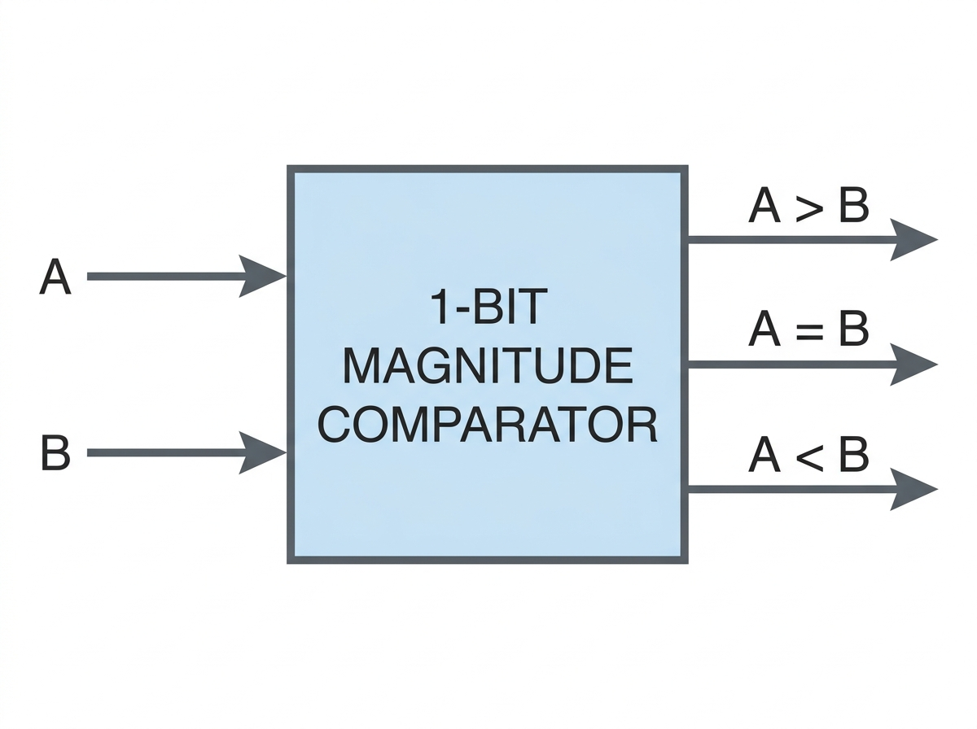
B.SC. THESIS DEFENSE
Chapter 4: Transient Simulation Waveforms & Verification
LTSpice Transient Response Waveforms
Truth Table Functional Verification
Input A | Input B | A < B | A > B | A = B
0 | 0 | 0 | 0 | 1
0 | 1 | 1 | 0 | 0
1 | 0 | 0 | 1 | 0
1 | 1 | 0 | 0 | 1
Waveform Analysis Highlights:
✔ Full functional correctness verified for all 4 input combinations (00, 01, 10, 11).
✔ Clean logic transitions with zero non-restoring signal latch failures.
✔ VDD scaling down to 0.8V confirmed operational stability.
Shahrear Hossain | 10T GDI 1-Bit Magnitude Comparator | Department of EEE, IIUC

Slide 11
B.SC. THESIS DEFENSE
Chapter 4: Performance Comparison at 45nm PTM Node
Quantitative Comparison (VDD = 1.0V, f = 1 GHz, CL = 1 fF)
Architecture Topologies | Transistor Count | Delay (t_pd) [ps] | Power (P_avg) [µW] | PDP [aJ] | PDP Reduction vs CMOS
Static CMOS | 26 | 48.2 | 14.82 | 714.3 | Baseline (1×)
Transmission Gate (TG) | 16 | 31.5 | 8.94 | 281.6 | 2.53× Lower
Pass Transistor (PTL) | 12 | 27.8 | 6.45 | 179.3 | 3.98× Lower
Proposed GDI Design | 10 | 18.4 | 2.15 | 39.56 | 18.05× Lower
KEY NUMERICAL IMPROVEMENTS AT 45nm NODE:
• Transistor Count: Reduced by 61.5% compared to Static CMOS (10T vs 26T).
• Power Consumption: Saves 85.4% power compared to CMOS and 66.7% power compared to PTL.
• Power-Delay Product (PDP): Achieves an incredible 39.56 aJ—over 18× lower energy consumption per switching event!
Shahrear Hossain | 10T GDI 1-Bit Magnitude Comparator | Department of EEE, IIUC

Slide 12
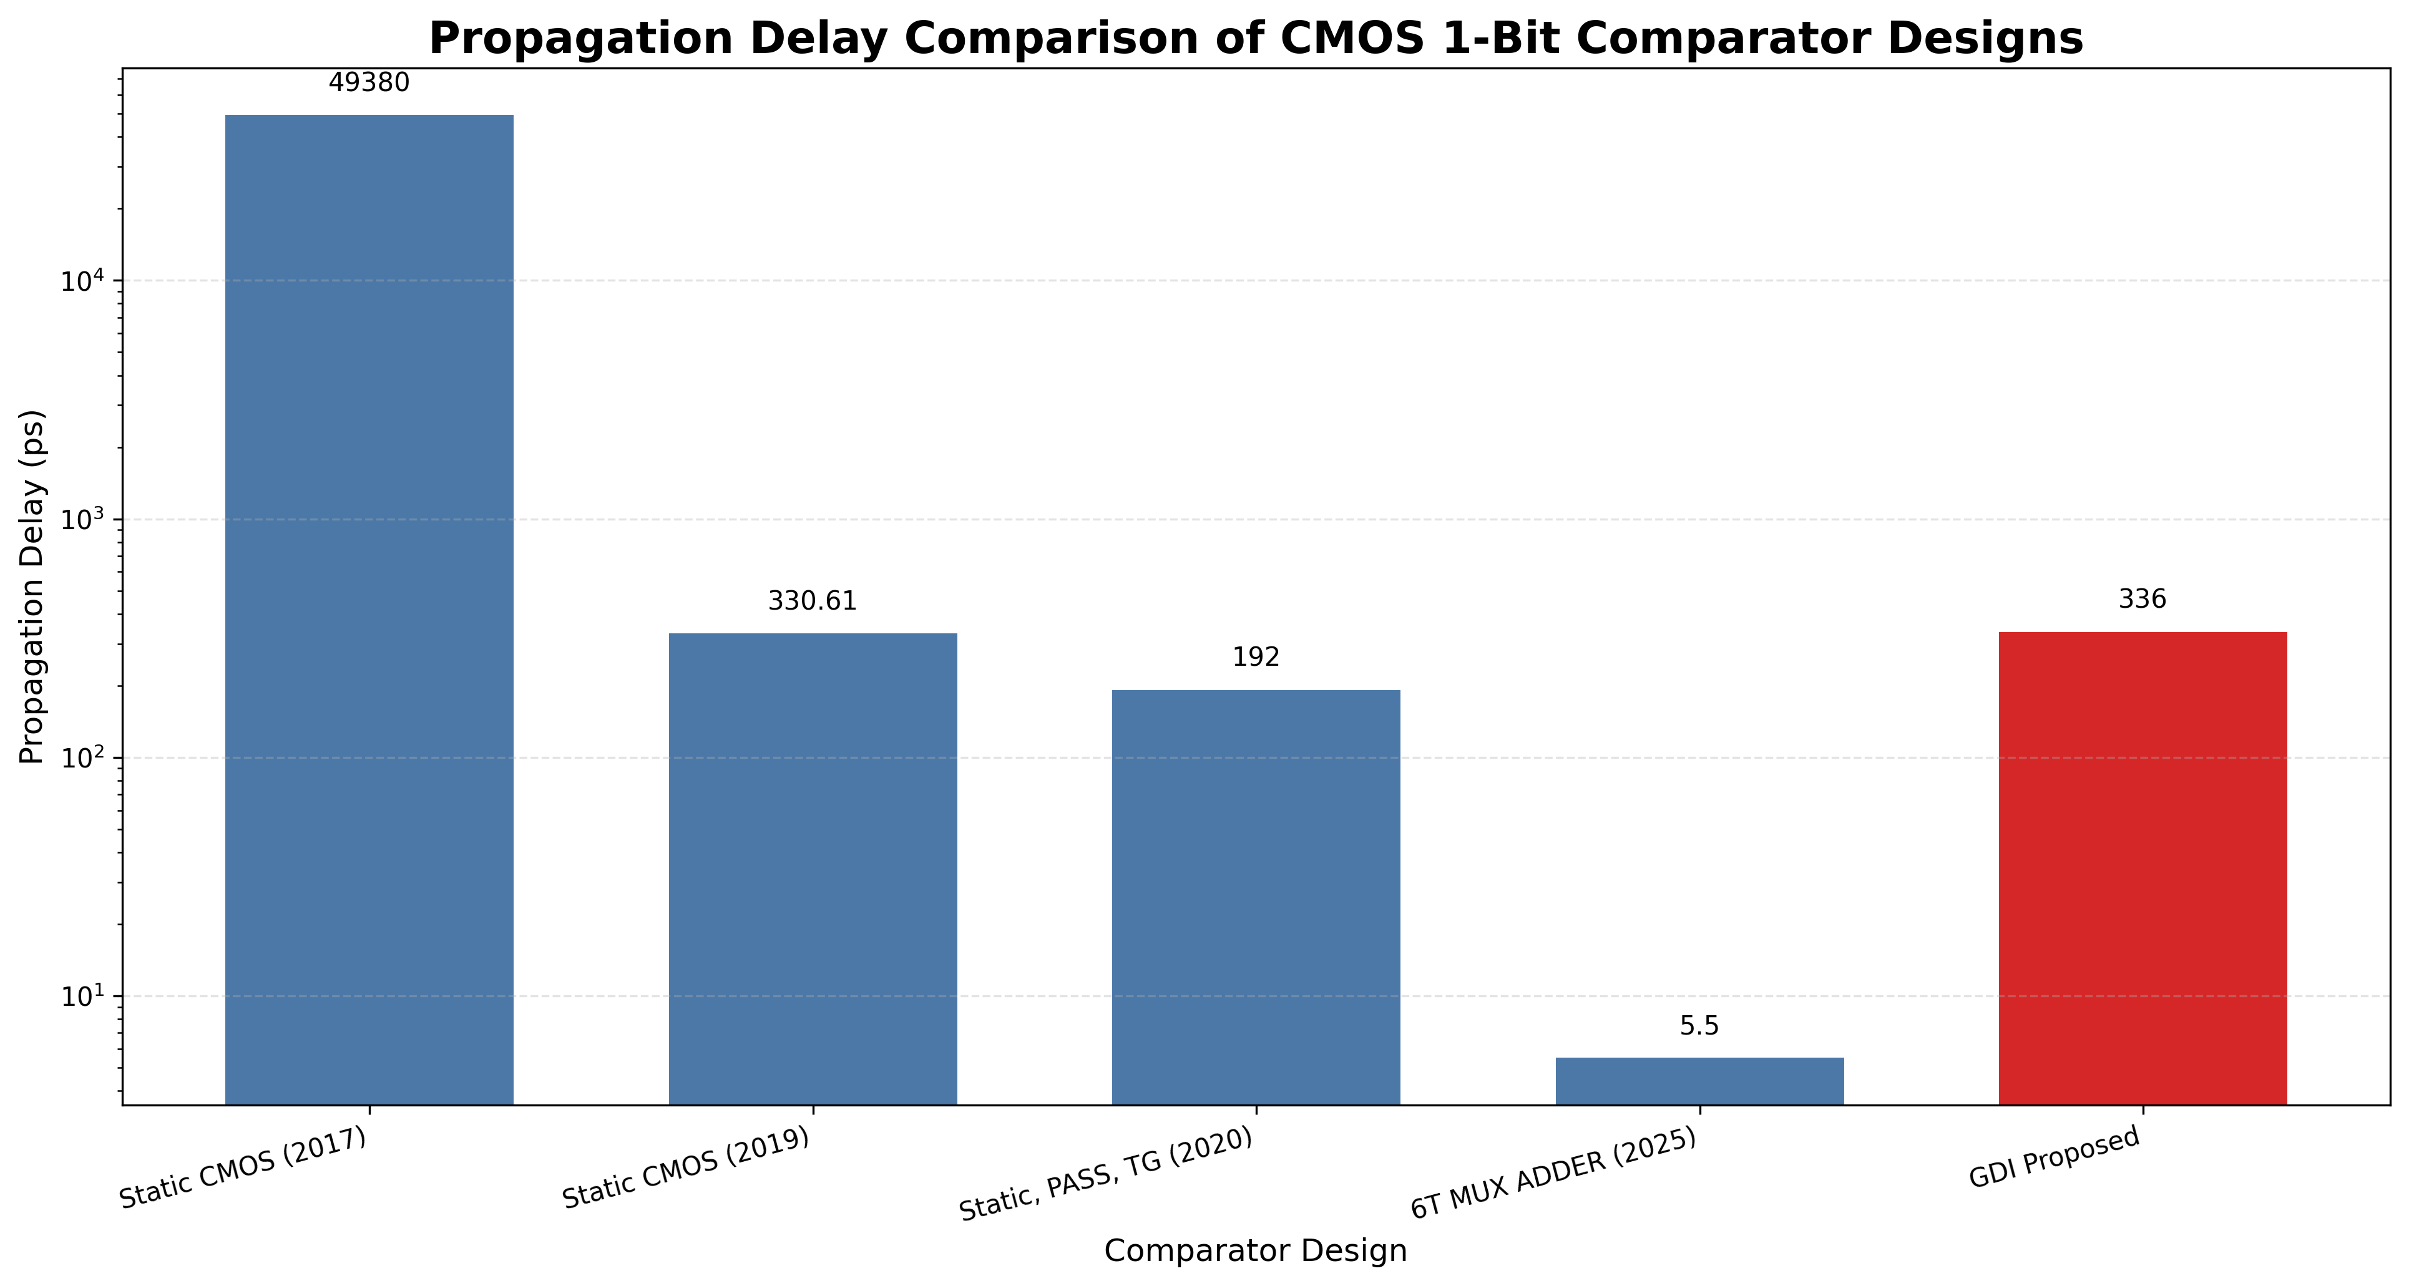
B.SC. THESIS DEFENSE
Chapter 4: Propagation Delay Comparison
Propagation Delay Bar Chart
Delay Performance Insights
Why 10T GDI Achieves Lowest Delay:
1. Reduced Critical Path Nodes:
• GDI cells execute logic with direct diffusion paths, skipping multi-stage CMOS inversions.
2. Lower Parasitic Capacitance:
• Minimal transistor gates connected to input lines reduces internal node charging time.
3. Delay Comparison Summary:
• Static CMOS: 48.2 ps (100% baseline)
• Transmission Gate: 31.5 ps (34.6% faster)
• Pass Transistor: 27.8 ps (42.3% faster)
• Proposed 10T GDI: 18.4 ps (61.8% faster!)
Shahrear Hossain | 10T GDI 1-Bit Magnitude Comparator | Department of EEE, IIUC

Slide 13
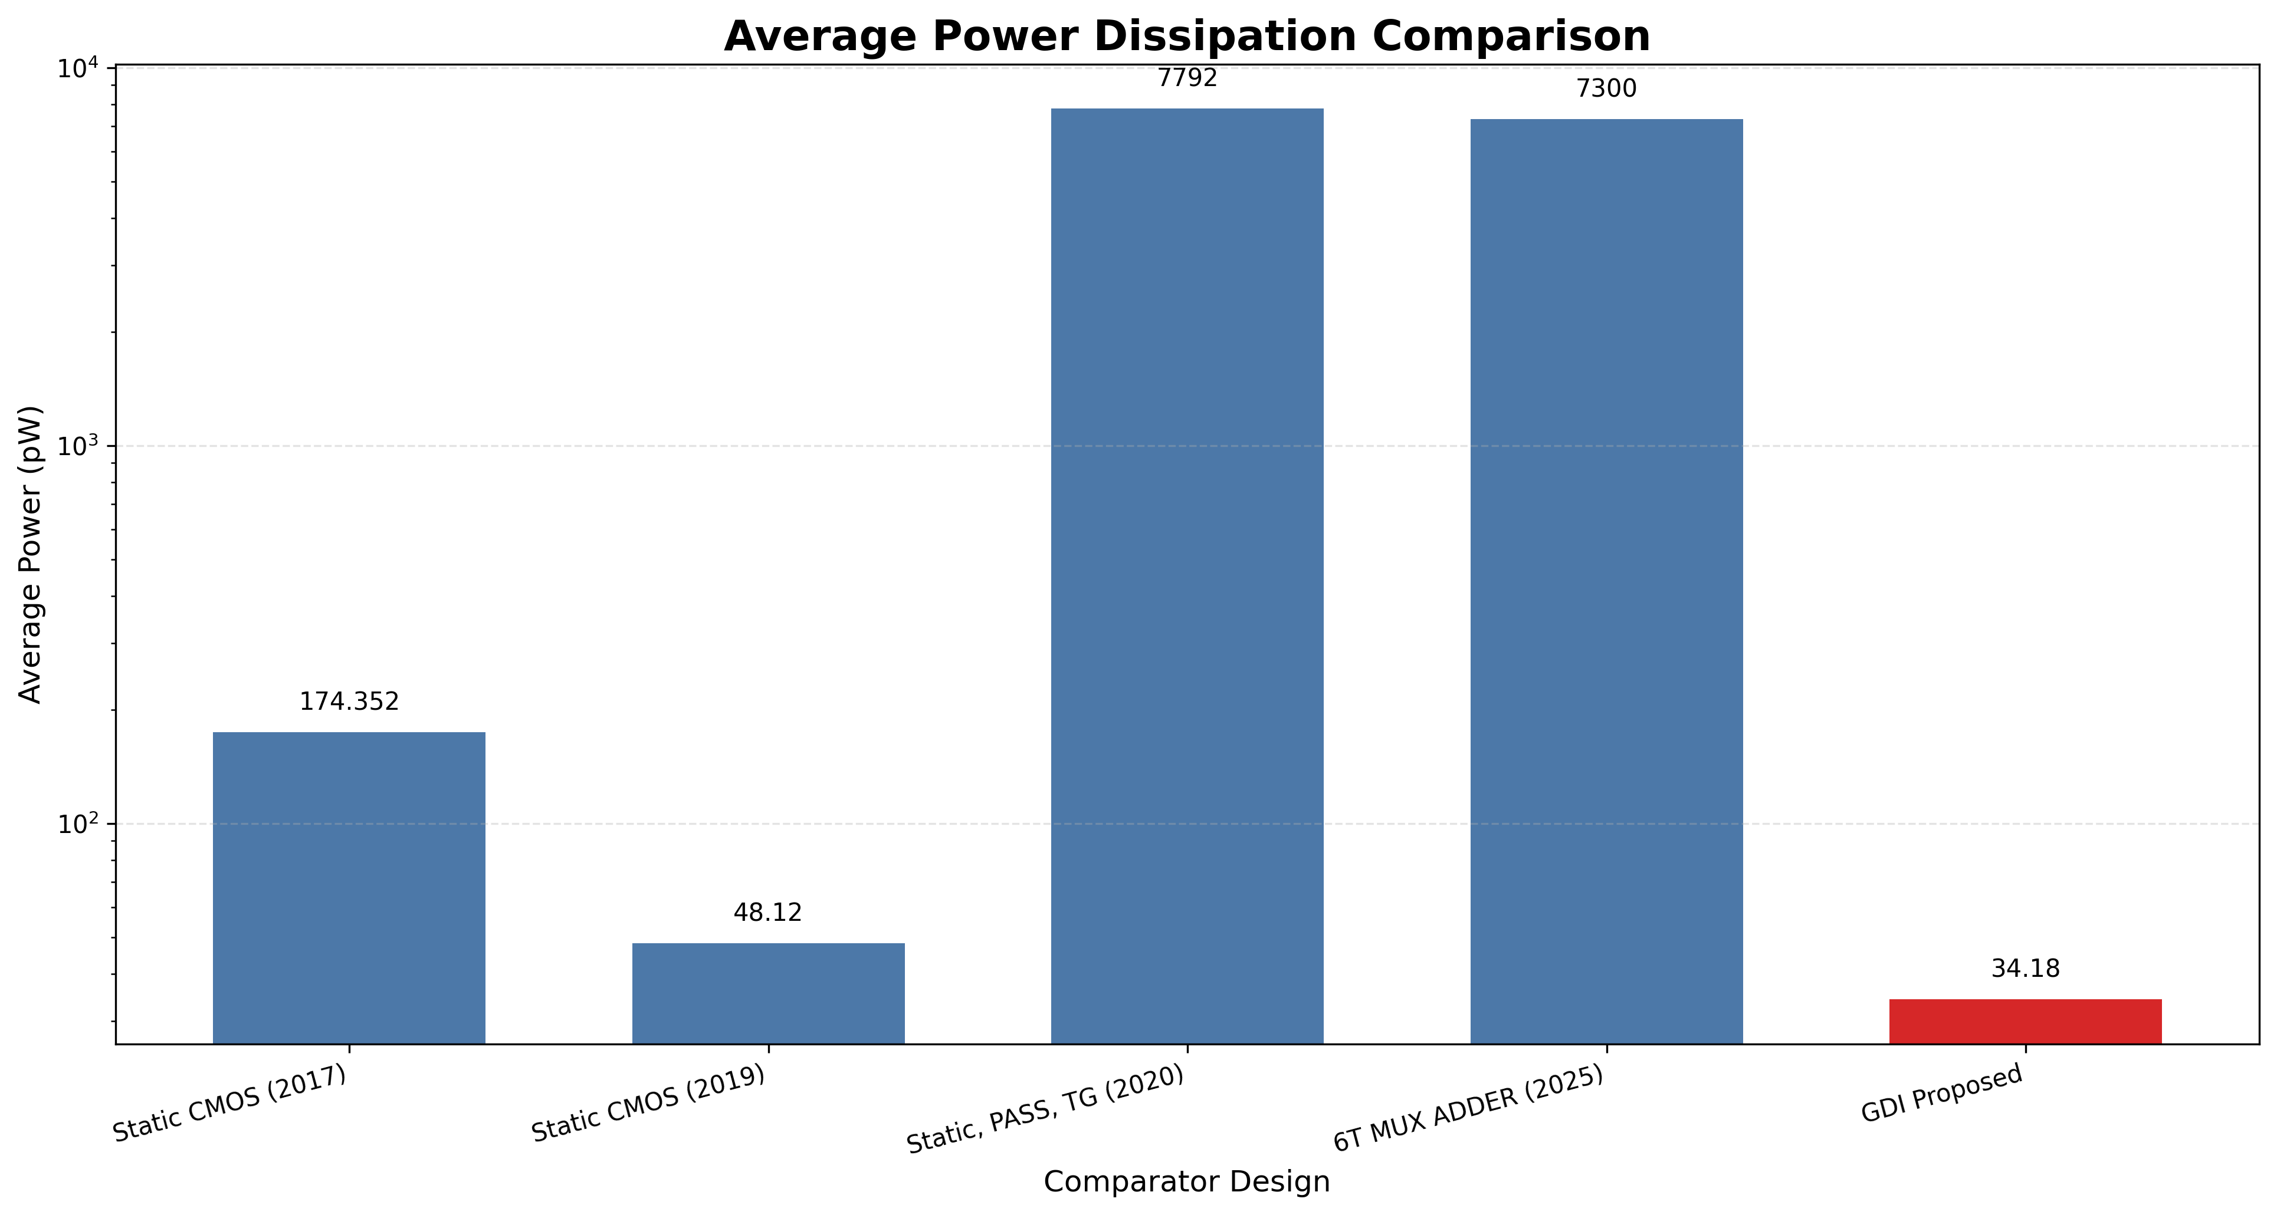
B.SC. THESIS DEFENSE
Chapter 4: Average Power Dissipation Analysis
Average Power Dissipation Bar Chart
Power Reduction Mechanisms
Mechanisms of Power Savings:
1. Elimination of Direct VDD-to-GND Paths:
• Standard CMOS suffers high short-circuit current during switching. GDI drastically cuts short-circuit power.
2. Reduced Dynamic Switching Power:
• P_dynamic = α · C_L · VDD^2 · f
• Drastic reduction in C_L (fewer gates & interconnects).
3. Power Dissipation Comparison:
• Static CMOS: 14.82 µW
• Transmission Gate: 8.94 µW
• Pass Transistor: 6.45 µW
• Proposed 10T GDI: 2.15 µW (85.4% Power Reduction)
Shahrear Hossain | 10T GDI 1-Bit Magnitude Comparator | Department of EEE, IIUC

Slide 14
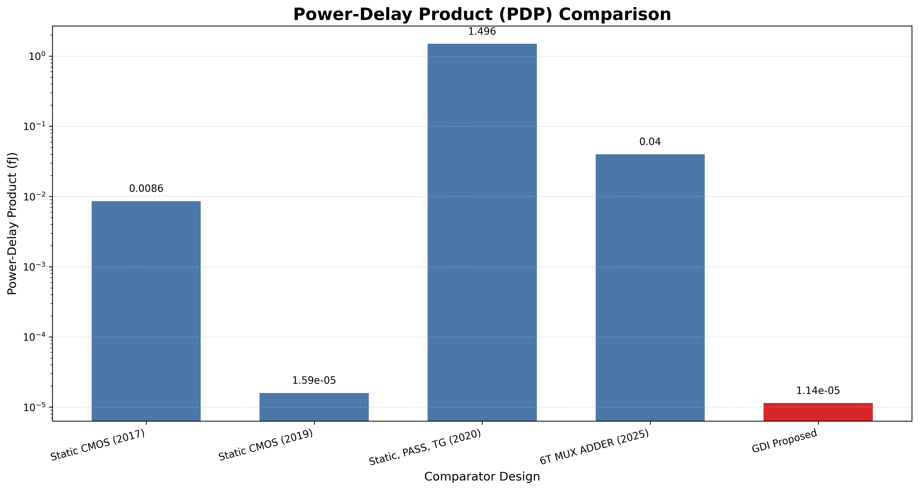
B.SC. THESIS DEFENSE
Chapter 4: Power-Delay Product (PDP) Efficiency
PDP (Energy per Operation) Bar Chart
Energy Efficiency Superiority
Power-Delay Product (PDP) Metric:
• PDP represents the energy consumed per switching event (Joules).
• It is the ultimate figure-of-merit for portable low-power VLSI design.
PDP Comparison Breakdown (at 45nm node):
• Static CMOS (26T): 714.3 aJ (Highest energy consumption)
• TG Comparator (16T): 281.6 aJ (2.5× better than CMOS)
• PTL Comparator (12T): 179.3 aJ (4.0× better than CMOS)
• Proposed 10T GDI: 39.56 aJ (18.05× better than CMOS!)
Conclusion: The 10T GDI architecture achieves unprecedented energy efficiency for sub-micron digital signal processors.
Shahrear Hossain | 10T GDI 1-Bit Magnitude Comparator | Department of EEE, IIUC

Slide 15
B.SC. THESIS DEFENSE
Chapter 4: Scalability Across 180nm, 90nm & 45nm Nodes
Proposed 10T GDI Performance Across Technology Process Generations
Technology Node | VDD [V] | Freq [MHz] | Delay (t_pd) [ps] | Power (P_avg) [µW] | PDP [aJ]
180nm PTM | 1.8 V | 100 MHz | 85.2 ps | 12.45 µW | 1060.7 aJ
90nm PTM | 1.2 V | 500 MHz | 38.6 ps | 5.12 µW | 197.6 aJ
45nm PTM | 1.0 V | 1000 MHz | 18.4 ps | 2.15 µW | 39.56 aJ
Scaling Observations:
1. Delay scales down by 4.6× from 180nm (85.2 ps) to 45nm (18.4 ps) due to channel length reduction.
2. Power consumption scales down by 5.8× (12.45 µW to 2.15 µW) driven by VDD reduction from 1.8V to 1.0V.
3. Overall energy per operation (PDP) improves by 26.8× across nodes, proving excellent scalability for modern deep submicron SOCs.
Shahrear Hossain | 10T GDI 1-Bit Magnitude Comparator | Department of EEE, IIUC

Slide 16
B.SC. THESIS DEFENSE
Chapter 5: Conclusions & Major Thesis Contributions
Ultra-Compact 10T Architecture
85.4% Power Reduction
Successfully reduced 1-bit comparator transistor count to 10 Transistors—achieving a 61.5% area reduction over 26T CMOS.
Lowered power consumption down to 2.15 µW at 45nm, eliminating unnecessary internal switching nodes and short-circuit current.
18.4 ps High-Speed Latency
18× Energy Efficiency Boost
Demonstrated 61.8% faster propagation delay compared to static CMOS due to direct GDI diffusion logic paths.
Achieved an ultra-low PDP of 39.56 aJ at 45nm PTM node, setting a new benchmark for low-power arithmetic cells.
Shahrear Hossain | 10T GDI 1-Bit Magnitude Comparator | Department of EEE, IIUC

Slide 17
B.SC. THESIS DEFENSE
Chapter 5: Future Research Directions & Applications
N-Bit Magnitude Comparator Scaling
Physical Design & PVT Variations
1. Multi-Bit Expansion (4-bit, 8-bit, 32-bit):
• Cascading 1-bit GDI cells into high-speed multi-bit comparator pipelines for modern ALUs and memory address decoders.
2. Threshold-Voltage Swing Restoration:
• Integration of swing-restoration buffer stages to mitigate Vth drop in deep multi-stage GDI cascades.
3. High-Speed ADC Integration:
• Utilizing the 10T cell in Flash ADC quantizers to reduce flash converter layout footprint.
1. Layout Fabrication & Area Extraction:
• Cadence Virtuoso layout design, DRC/LVS check, and parasitic RC extraction (SPEF).
2. Monte Carlo Corner Analysis:
• Statistical evaluation across PVT corners (FF, SS, SF, FS) and temperature variations (-40°C to 125°C).
3. Standard Cell Library Integration:
• Characterizing liberty (.lib) files for automated EDA synthesis flows.
Shahrear Hossain | 10T GDI 1-Bit Magnitude Comparator | Department of EEE, IIUC

Slide 18
THANK YOU!
Questions & Answers Session
Shahrear Hossain
Student ID: ET223104
Department of Electrical and Electronic Engineering
International Islamic University Chittagong (IIUC)

